Slide 1
BANK MANAGEMENT SYSTEM
SK. KALEEM AFROZ (AP23110010337)
K. SAI PRASANTH (AP23110010317)
JAYANTH RAMAKRISHNAN (AP23110010340)
C. SESANK (AP23110010315)

Slide 2
AIM:
To design and implement a simple Bank Management System in C++ that allows users to create and manage Savings Accounts and Current Accounts while providing functionalities like deposit, withdrawal, transfer, mobile banking, account activation, and deactivation.

Slide 3
Description :
This project provides a basic banking system that facilitates operations for Savings and Current accounts. Users can interact with the program through a menu-driven interface to perform various banking transactions. The program implements object-oriented concepts such as inheritance, polymorphism, and dynamic memory allocation for extensibility and code reusability.

Slide 4
Concepts Used:
Classes and Objects: Representing the core entities such as Account, SavingsAccount, CurrentAccount, and Bank.
Inheritance: SavingsAccount and CurrentAccount inherit from the base class Account to share common functionalities.
Polymorphism: Virtual functions like withdraw and displayAccountInfo enable specialized behavior for derived classes.
Dynamic Memory Allocation: Accounts are created dynamically and managed via pointers stored in a vector.
Encapsulation: Secure access to account properties through getter and setter methods.
Menu-driven Programming: Allows users to interactively perform tasks through a structured interface.

Slide 5
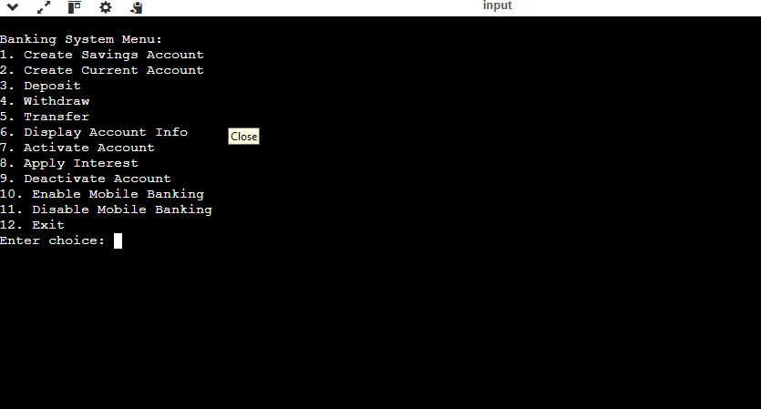
Main Menu of the Program:

Slide 6
Explanation of Features:
1. Creation of Savings Account
Prompts the user for:
Account holder's name
Initial deposit amount
Interest rate (e.g., 0.03 for 3%)
Creates a SavingsAccount object with the specified details and assigns a unique account number.
Displays a success message along with the account number.

Slide 7
2. Creation of Current Account
Prompts the user for:
Account holder's name
Initial deposit amount
Overdraft limit
Creates a CurrentAccount object and assigns a unique account number.
Displays a success message with the account number.

Slide 8
Deposit:
Allows the user to deposit a specified amount into a chosen account.
Updates the balance and shows the updated balance.

Slide 9
4. Withdraw:
Enables users to withdraw an amount from their account:
Savings Account: Ensures the amount does not exceed the balance.
Current Account: Allows overdraft up to the defined limit.
Updates the balance after a successful withdrawal.

Slide 10
5. Transfer
Facilitates transferring money between two accounts:
Deducts the amount from the sender's account.
Deposits the amount into the receiver's account.
Displays updated balances for both accounts after the transaction.

Slide 11
6. Display Account Information:
Displays:Account number
Account holder's name
Current balance
Account status (active/inactive)
Mobile banking status
For CurrentAccount, also displays the overdraft limit.

Slide 12
7. Activate Account:
Activates a deactivated account, allowing transactions to be performed.
8. Apply Interest (Savings Account only):
Applies the interest rate to the balance of a savings account and updates the balance.
9. Deactivate Account:
Marks an account as inactive, preventing further transactions.
10. Enable/Disable Mobile Banking:
Toggles the mobile banking service for an account.

Slide 13
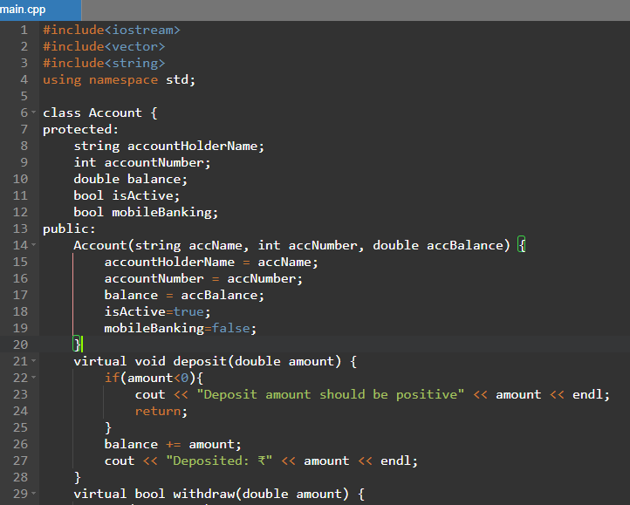
CODE:

Slide 14
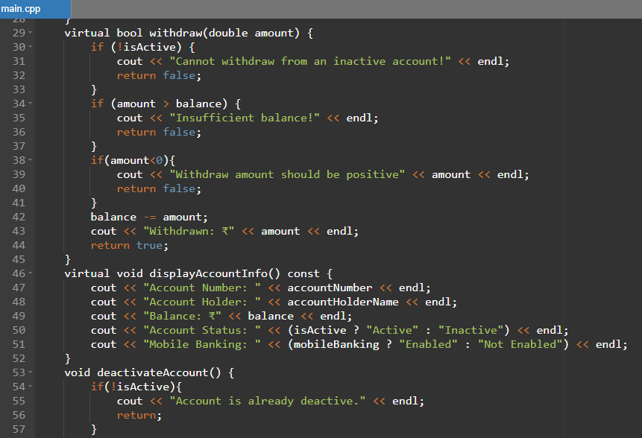

Slide 15
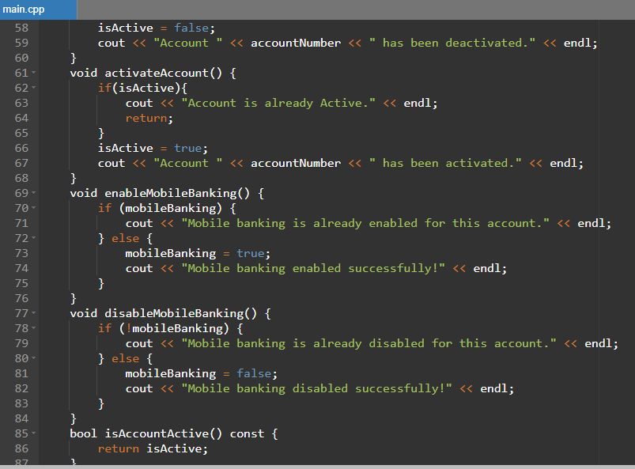

Slide 16
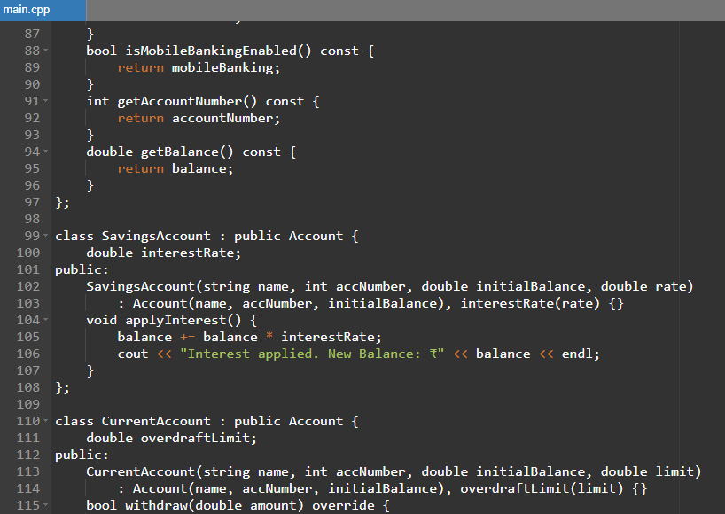

Slide 17
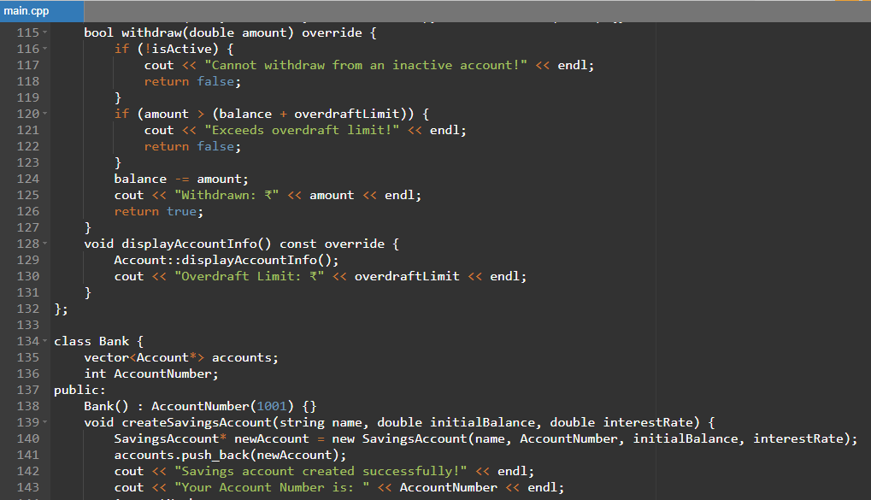

Slide 18
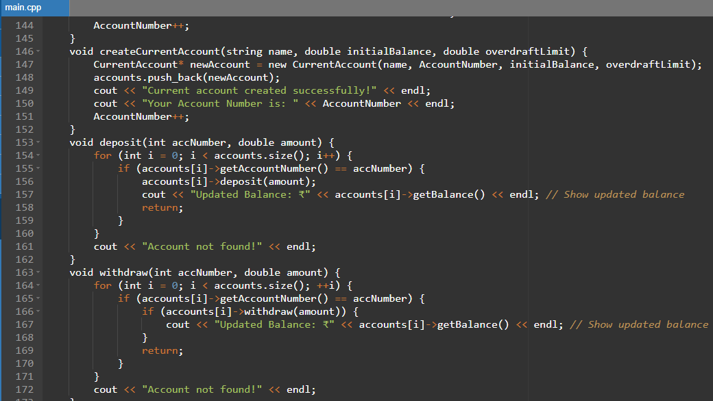

Slide 19
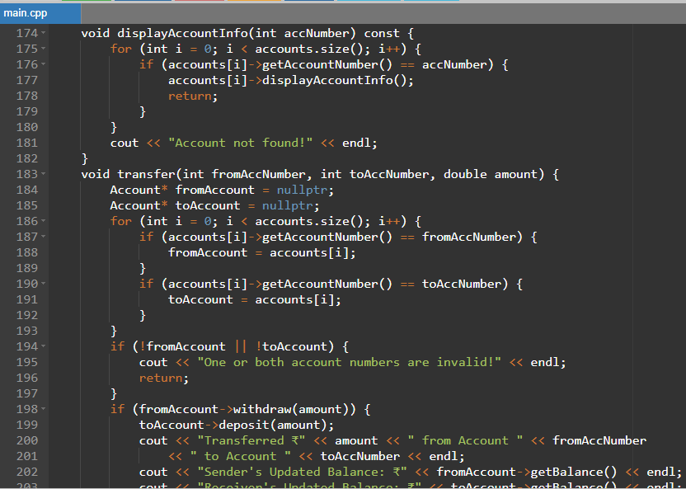

Slide 20
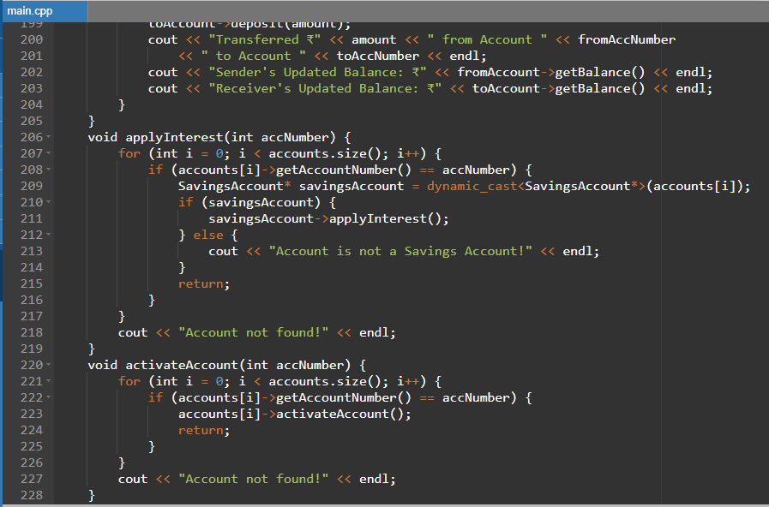

Slide 21
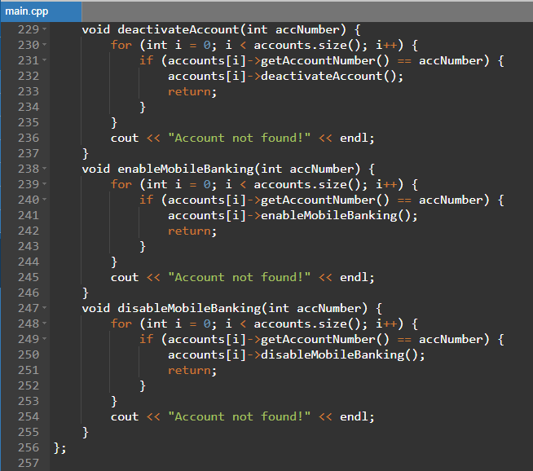

Slide 22
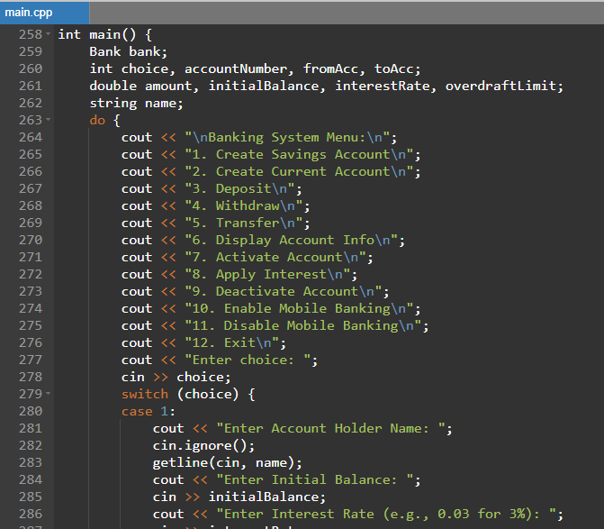

Slide 23
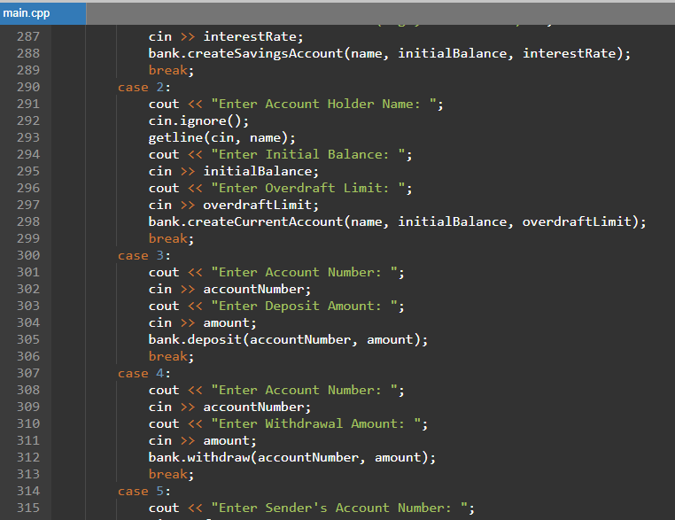

Slide 24
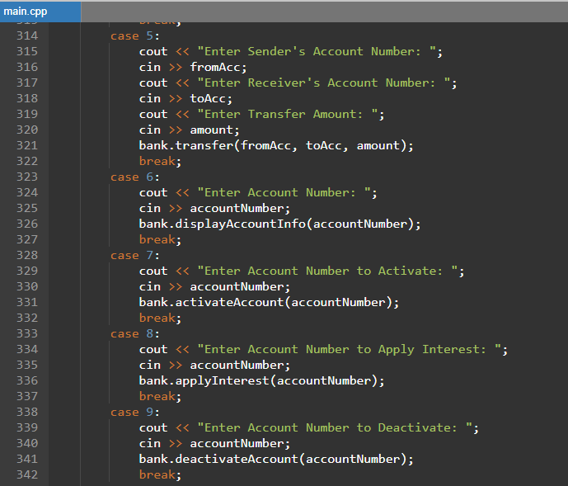

Slide 25
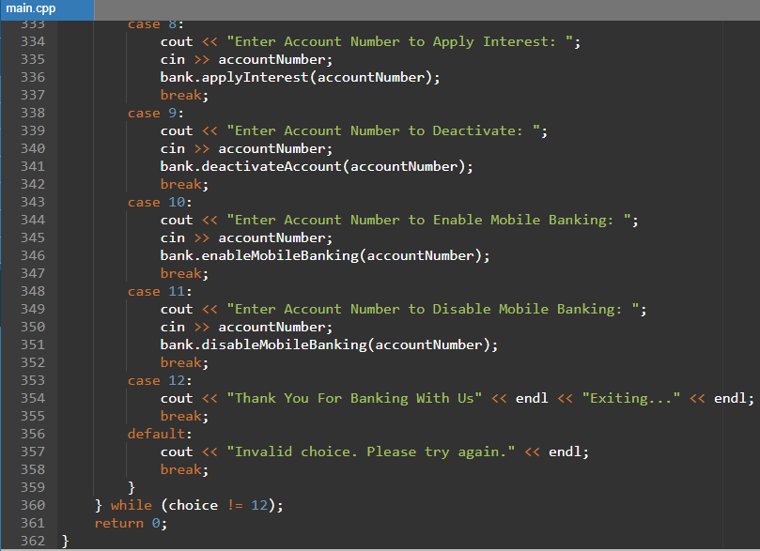

Slide 26
Conclusion:
This project demonstrates a practical implementation of object-oriented programming concepts to create a user-friendly Bank Management System. The modular design ensures extensibility, making it easy to add new features or improve functionality. This program serves as a foundational model for more complex banking systems with advanced features like data persistence, online banking, and real-time transaction tracking.

Slide 27
THANK YOU !

